Slide 1
Large-Scale and Multi-Structured Databases
Nexus Scholar
Andrea Covelli
Luca Giannini
Daniele Congiusti

Slide 2
Application Highlights
The idea consists of creating a platform dedicated to analyzing a wide database of scientific papers of all types, which allows users to identify and view hidden connections in the field of research.
We will offer such powerful analytics, the implementation of which is not easy in traditional databases. Here are some examples:
  Discover researchers and most influential papers using ranking algorithms (i.e. Pagerank)
  Figure out shortest collaboration paths between two researchers (Erdős number)
  Analyze research trends emerging over time

Slide 3

Actors (i)
Search papers by title or author
View basic author profiles
Restricted analysis
may do
Unregistered user
All unregistered user permissions
Visualize citation networks
View Trend Analysis
Save searches
may do
Registered user
Manage users
Monitor database
Trigger data ingestion
may do
Administrator

Slide 4
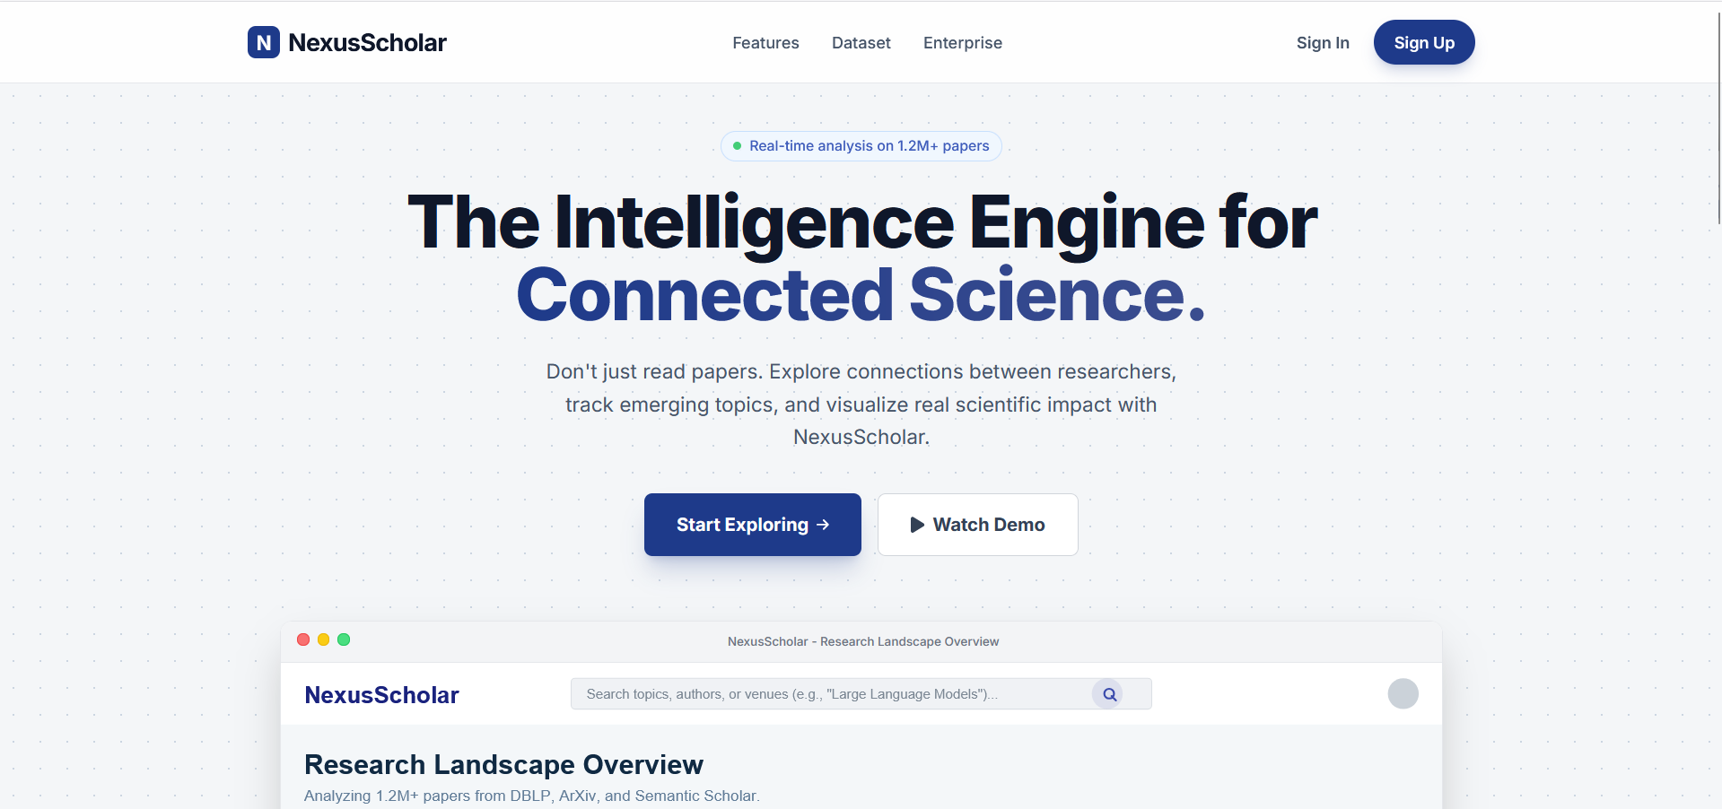
MockUps
Unregistered user / Registered User
Homepage Nexus Scholar

Slide 5
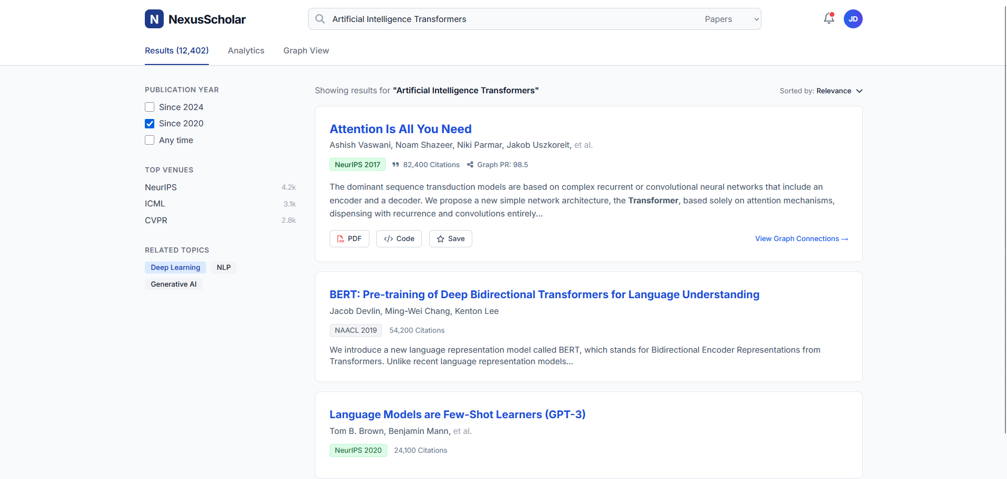
MockUps
Unregistered user / Registered User
Search page (unregistered user can do limited researches)

Slide 6
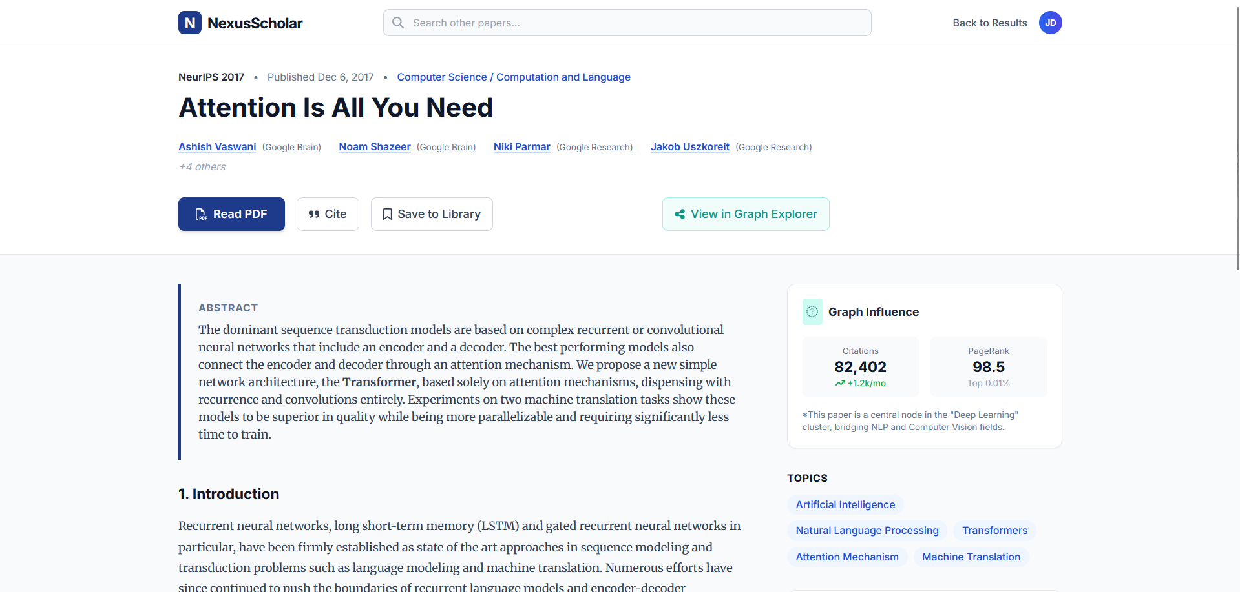
MockUps
Unregistered user / Registered User
Paper detail page (unregistered user can view only a part of overall informations)

Slide 7
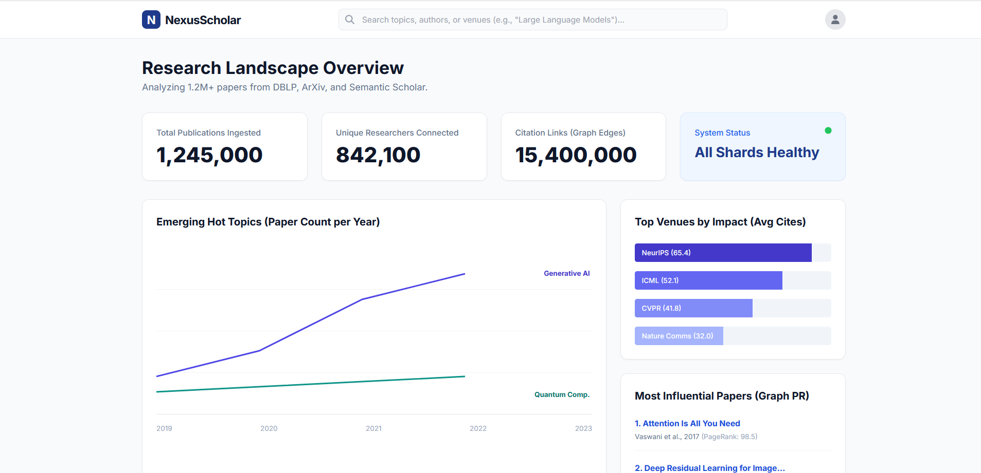
MockUps
Unregistered user / Registered User
Analytics result page (unregistered user can only do limited analytics)

Slide 8
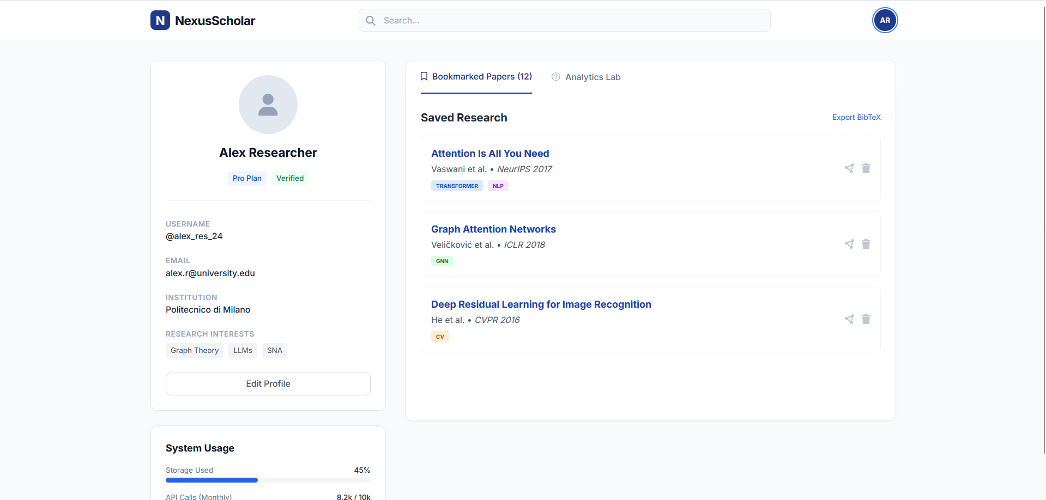
MockUps
Registered User
Registered user personal bookmarked papers section

Slide 9
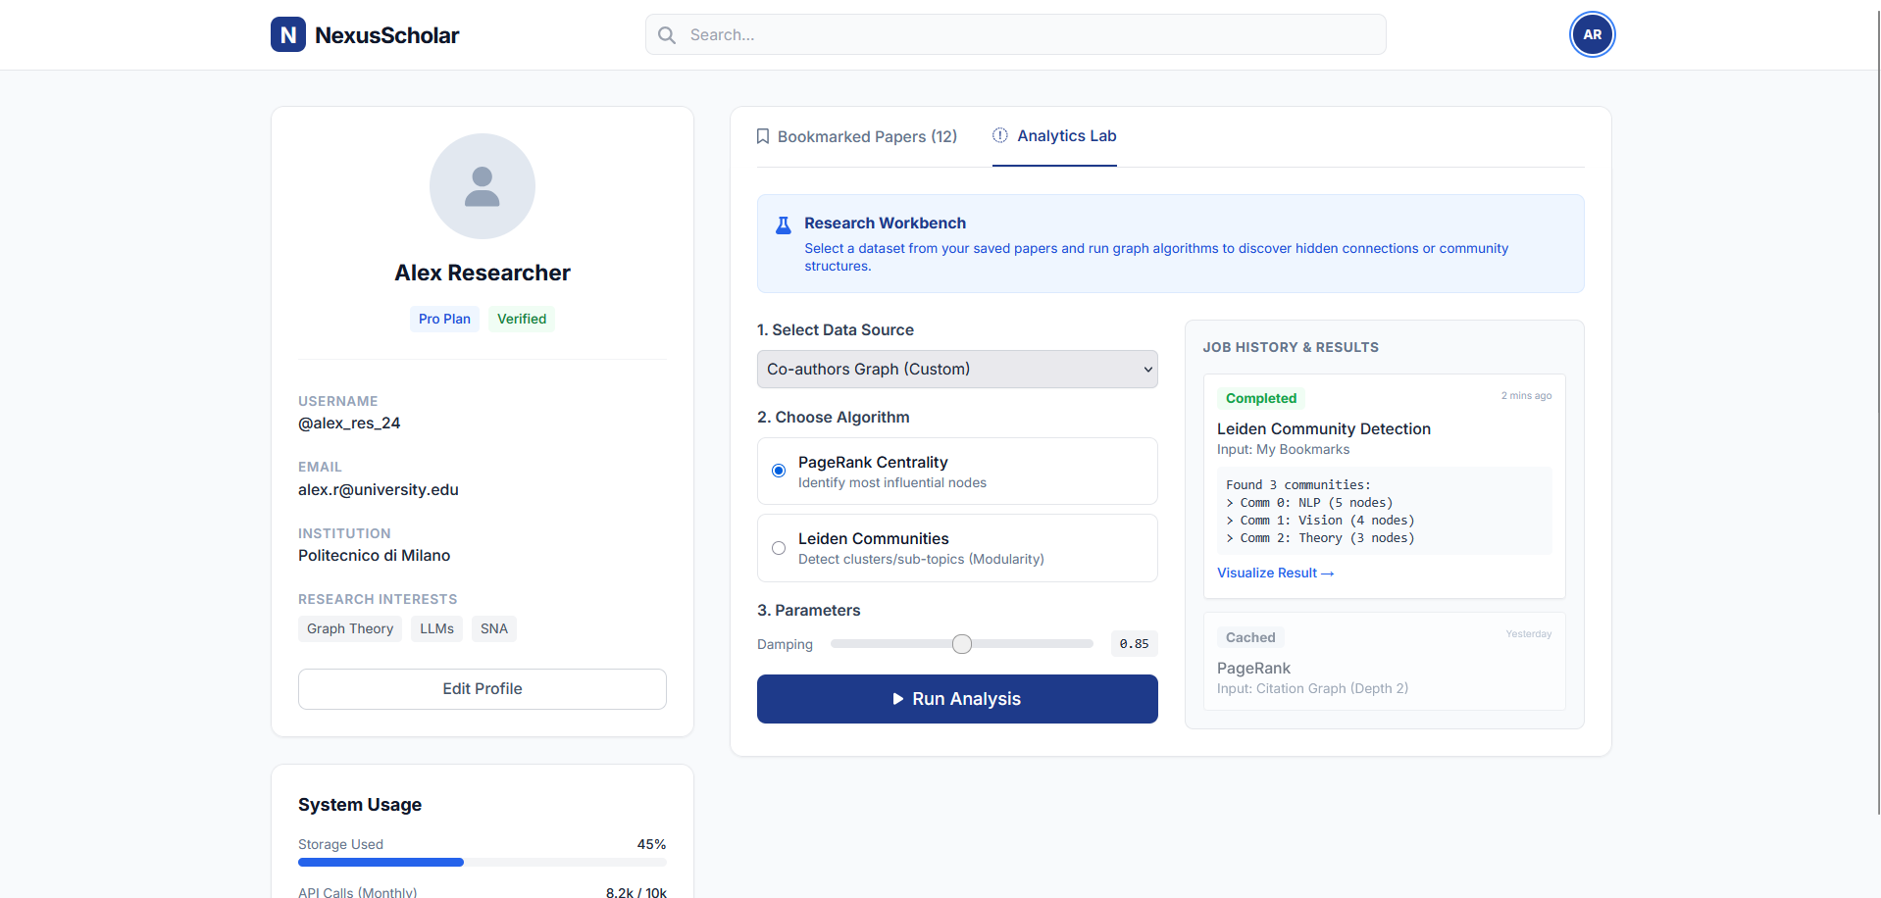
MockUps
Registered User
Registered user personal analytics section

Slide 10
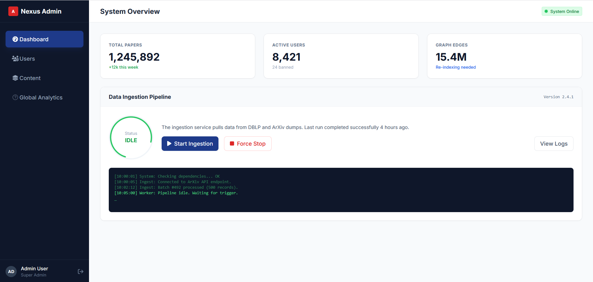
MockUps
Admin
System state page

Slide 11
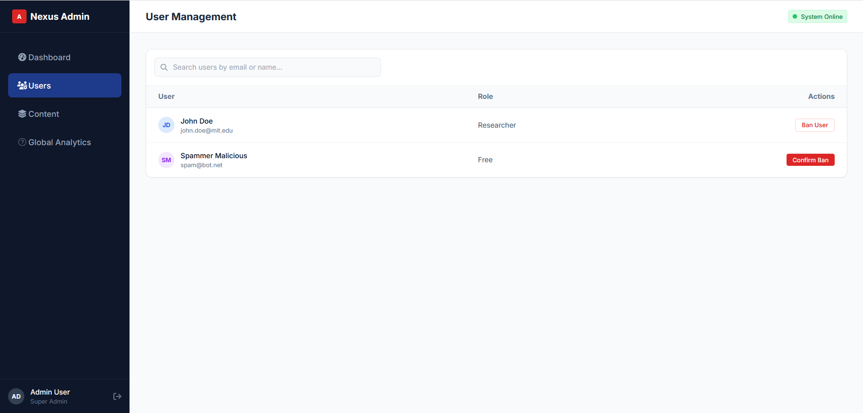
MockUps
Admin
System user management page

Slide 12
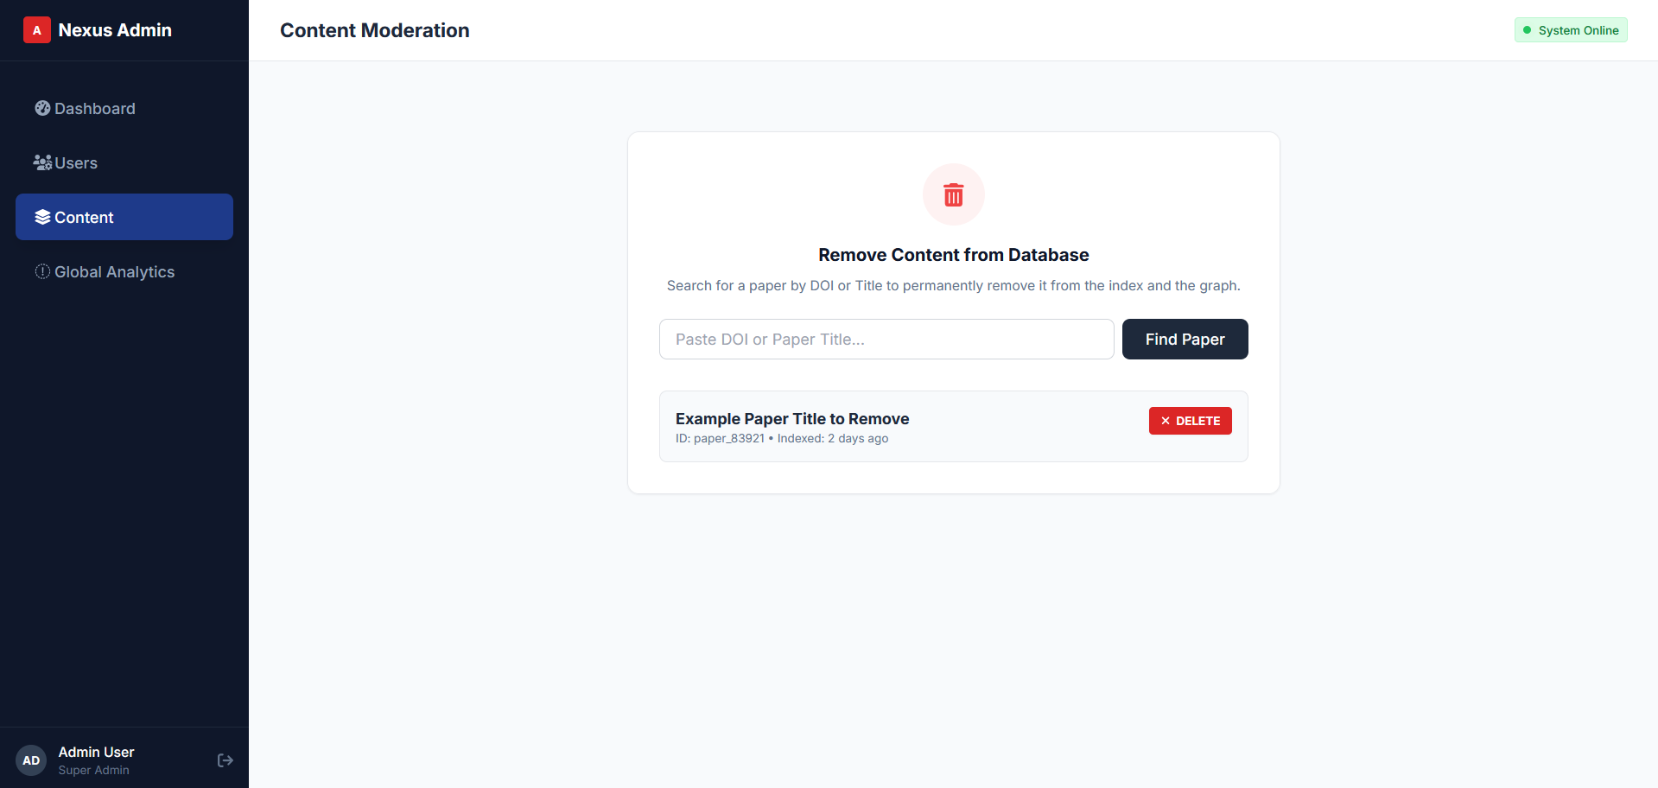
MockUps
Admin
System paper management page

Slide 13
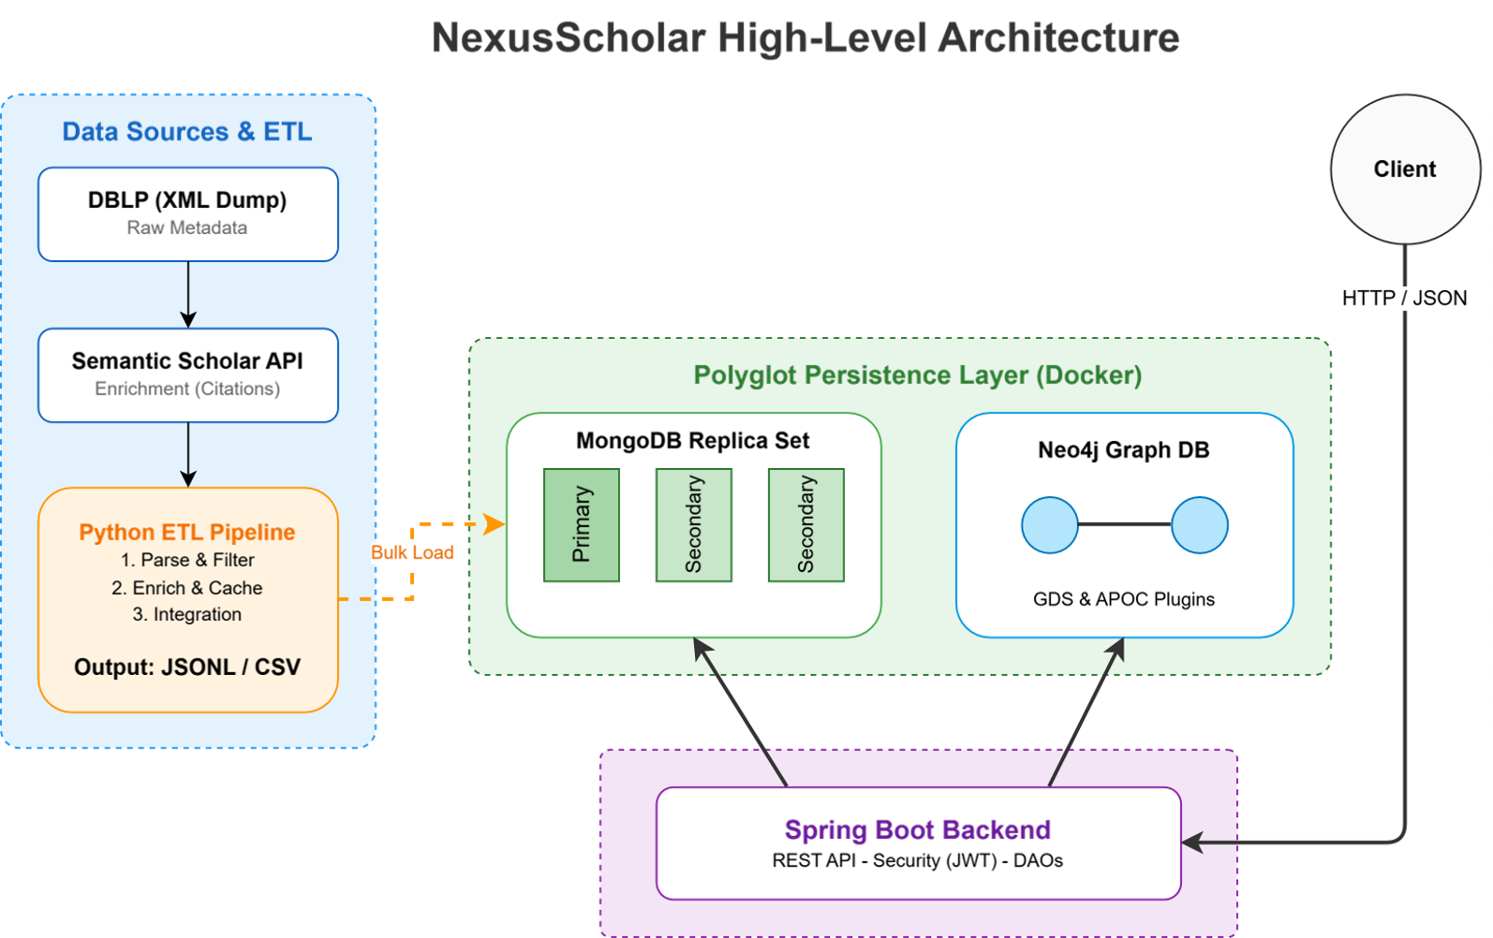

Slide 14


Dataset Description
Source: DBLP Computer Science Bibliography (XML Dump), Semantic Scholar (S2) API (JSON)
Description: DBLP provides comprehensive bibliographic information on computer science journals and proceedings. S2 offers pre-print access across various scientific fields.
Volume: High. DBLP dump is ~1GB containing:
Variety: Medium-High. Data from distinct sources (Dump vs. API) and formats (XML and JSON)
Velocity/Variability: Low-Medium. DBLP provides monthly dumps. Semantic Scholar has higher velocity (daily updates)
+6 mln publications
+3 mln authors

Slide 15


Dataset Pre-processing
Preliminary steps required to set the environment:
  python virtual environment
  mongo key-file
  docker
Pre-processing phase consists in 4 phases:
  Parsing and filtering DBLP dataset
  Collecting Semantic Scholar API data
  Enrich DBLP data with Semantic Scholar collected data
  Load data in 3 mongoDB and 1 Neo4j instances

Slide 16
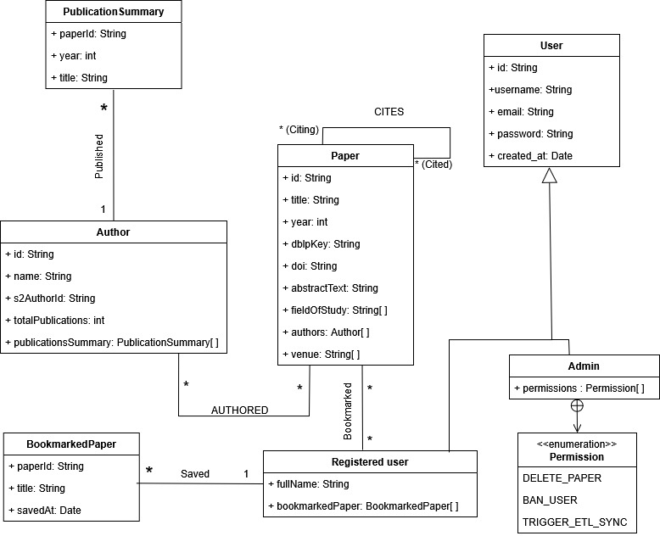
UML Design Class Diagram
Notes:
Let’s start with the academic part of our diagram
Paper let’s say some field like title, year, doi.
Let’s about the recursive relathionship CITES and the relathionship AUTHORED that is the essesiatial structure of our academic citation network
Author class doesn’t hold just the anagraphics of an author but also a lightweight snapshot of the papers that he was co-author
Now let’s focus on the user management part of our diagram. We have a base class User containing credentials and common data.
From this we have two inherited classes Registered User and Admin
The admin holds a list of Permission. As you can see from the enumeration at the bottom, the Admin has special privileges, such as Banning users
Finally, on the bottom left, we see how registered users interact with papers. A Registered user can save papers. This functionality is modeled via the BookmarkedPaper class, which acts as a lightweight reference or snapshot, allowing users to build their own personal library."

Slide 17

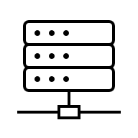


Application non-functional requirements
Architectural Constraints, Security & Reliability Standards
1. SECURITY & ACCESS CONTROL
2. SYS-ARCHITECTURE & CONSISTENCY
Data Encryption: Passwords must be secured via BCrypt hashing before storage.
Stateless Authentication: API must be secured via JWT in headers.
Protection: API endpoints must be stateless.
Design pattern: Strict Layered Architecture which must be (MVC + DAO + DTO) ensuring SoC.
CAP Theorem Strategy: System must be designed as CP to ensure data integrity.
3. INFRASTRUCTURE & PERFOMANCE
4. QUALITY ASSURANCE
Platform Agnostic: Fully containerized deployment using Docker
Interoperability: RESTful API exposing data in JSON format.
Optimization: Strategic Indexing on MongoDB and Neo4j to handle large-scale dataset queries
Robustness: Code Coverage must be at least >90%.
Reliability: CI pipeline integration should prevent regression in builds.

Slide 18

Document DB Design
Papers _id: 'P000001', title: 'Accelerating Ecological ...', year: 2021, dblp_key: 'conf/…', doi: '10.1609/aaai.v35i17.17728', abstract: 'The rise of neural ...', fields_of_study: [ 'Computer Science' ], authors: [ { id: 'A00001', name: ‘….’ }, … ] , venue: [ 'AAAI' ] | Authors _id: 'A00003', name: 'Qinru Shi', s2_author_id: '39986387', total_publications: 4, publications_summary: [{ paper_id: 'P000001', year: 2021, title: 'Accelerating Ecological ...' }]
Registered Users _id: 'U000002', username: 'arthur_garrison', full_name: 'Arthur Garrison', email: ‘artur_garrison@mail.com', password_hash: ‘$2°S9HJ…', created_at: ISODate('2025-03-08T04…') bookmarked_papers: [{ paper_id: 'P000001', title: 'Accelerating Ecological ...', saved_at: ISODate('2026-…’)}] | Admins _id: 'AD05', username: 'melinda_cook_admin', email: 'scelerisque@outlook.org', password_hash: '$2b$0…', created_at: ISODate('2025-03-25T18:5…'), permissions: [‘BAN USER']

Slide 19
Document DB Design
Venue Impact Analysis | Collaboration Evolution
db.papers.aggregate([ { $unwind: "$venue" }, { $group: { _id: { venue: "$venue", year: "$year"}, paper_created: {$sum : 1} } }, { $sort: {"_id.year":1, paper_created:-1} }, { $project: { "_id" : 0, "venue" : "$_id.venue", "year" : "$_id.year", "paper_created": "$paper_created" }}}) | db.papers.aggregate([ { $project:{ year: "$year", num_authors: {$size: "$authors"} }}, { $group: { _id:{year: "$year"}, avg_authors:{$avg: "$num_authors"} } }, { $sort: {"_id.year":1} }, { $project: { _id : 0, year : "$_id.year", avg_authors :"$avg_authors" }}})
Notes:
Venue Impact Analysis
This feature ranks publication venues (conferences, journals, workshops) based on their output volume within a specific solar year. This allows researchers to identify the most active and dominant venues over time.
Collaboration Evolution
This analysis calculates the average number of authors per paper for each year. An upward trend in this metric typically indicates a shift towards larger research teams.

Slide 20
Document DB Design
Trend Analysis Hot Topics | Prolific Author Identification
db.papers.aggregate([ { $unwind: "$fields_of_study" }, { $group:{ _id: { field_of_study:"$fields_of_study", year:"$year" }, paper_created: {$sum:1} } }, {$sort: {"_id.year":1, "paper_created": -1}}, {$project : { _id:0, field_of_study: "$_id.field_of_study", year: "$_id.year", paper_created: "$paper_created" }}]) | db.authors.aggregate([ { $unwind: "$publications_summary"}, {$group: { _id: { _id: "$_id", name: "$name", year: "$year" }, paper_created: {$sum:1}} }, {$match:{ paper_created: {$gt: X} }}, {$group:{ _id: "$_id._id", name: {$first: "$_id.name"} }}, { $project : { _id:0, authorId: "$_id", authorName: "$name" }}))
Notes:
Trend Analysis Hot Topics
This process calculates the publication volume per field of study over time, allowing the application to visualize which
topics are gaining traction (“Hot Topics”) and how research focus has shifted across different years.
Prolific Author Identification
The system includes a feature to identify “Prolific Authors,” defined as researchers who have published a
significant volume of work within a single solar year. This query is parameterizable, allowing the system
to set a specific threshold (e.g., more than X papers) to filter for high-output individuals.

Slide 21
Document DB Design
Paper Leaderboard
db.registeredUsers.aggregate([ {$project : { _id : 0, bookmarked_paper :"$bookmarked_papers"} }, {$unwind: "$bookmarked_paper"}, {$match: {$expr: {$and: [ { $eq: [ { $year: "$bookmarked_paper.saved_at" }, YYYY ] }, { $eq: [ { $month: "$bookmarked_paper.saved_at" }, MM ]}]}}}, {$group :{ _id:{ paper_id : "$bookmarked_paper.paper_id", title: "$bookmarked_paper.title" }, bookmarked_received: {$sum:1}}} {$project : { _id : 0, paper_id : "$_id.paper_id", title: "$_id.title", bookmarked_received :"$bookmarked_received"}}, {$sort :{"bookmarked_received":-1}}, {$limit: 5} ])
Notes:
Paper Leaderboard
This query identifies the ranking of the most bookmarked paper of a month. This identified the hot papers and so the most important paper in month.

Slide 22
MongoDB Replica Set Configuration
We set this 2 parameters in MongoDB:
readPreference=primary
This ensures that read operations are performed exclusively on the Primary server. Consequently, users are guaranteed to see only the latest version of the data.
w=majority
This implies that MongoDB acknowledges a write operation only after the data has been replicated to many of the servers.
If a network partition occurs, the following sequence takes place:
The isolated Primary steps down because it can no longer communicate with much of the set.
The remaining nodes must hold an election to select a new Primary. During this election phase, both read and write operations are blocked.

Slide 23
MongoDB Indexes
Index Creation:
This index implements a Full-Text Search strategy. This allows users to find papers by querying keywords that may appear in either the title or the abstract, with results ranked by relevance.
db.papers.createIndex( { title: "text", abstract: "text" }, { weights: { title: 10, abstract: 3 }, name: "textPaperIndex" } )

Slide 24
MongoDB Indexes
Index Creation:
db.authors.createIndex( { name: 1 }, { name: "authorsIndex" } ) | db.registeredUsers.createIndex( { full_name: 1 }, { name: "usersIndex" } ) | db.admins.createIndex( { username: 1 }, { name: "adminIndex" } )
Collection | Query | Docs Examined (No Index) | Docs Examined (Index) | Improvement
Authors | Search w. Prefix | 148,434 | 35 | ≃ 99,9%
RegisteredUser | Search w. Prefix | 100 | 2 | 98,0%
Admin | Search w. Prefix | 10 | 1 | 90,0%

Slide 25
Discussion on MongoDB Data Sharding
Primary Sharding Candidate: "papers" collection
Reason: High cardinality and continuous growth (Semantic Scholar updates daily; DBLP updates monthly).
Challenge: The collection grows rapidly, requiring horizontal scaling.
Sharding Key Selection:
Range-based on field "year": Causes a "Monotonically Increasing Key" problem.
Hashed sharding on field "_id": Ensures writes are randomly and evenly distributed across shards (avoiding hot-shards).

Slide 26

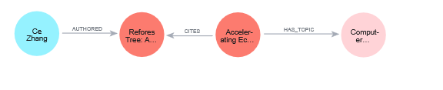
Graph DB Design
3 types of nodes:
  Paper : { paperId, title }
  Author : { authorId, name }
  Topic: { topicId, name }
3 types of relationships:
  AUTHORED : (Author) – [AUTHORED] -> (Paper)
  CITES: (Paper) – [CITES] -> (Paper)
  HAS_TOPIC: (Paper) – [HAS_TOPIC] -> (Topic)
Author
Paper
Paper
Topic
Notes:
Show the Neo4j data model (show the graph structure in terms of nodes, edges and properties) and justify choices.

Slide 27
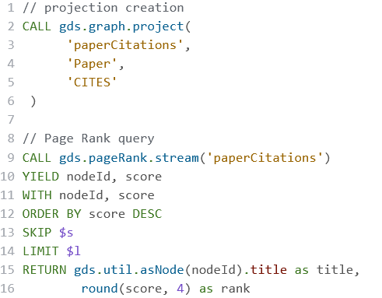
Graph DB Design
Page ranking papers
Domain-specific query: Estimate importance of papers considering number of citations that involves it
Graph-specific query: execute pagerank algorithm on paperCitations subnetwork, in order to obtain a score based on incoming edges of :CITES relationship
Notes:
Show the most important implemented ”graph-based” queries (suggestions and analytics) highlighting how the system benefits from the proposed DB design. Use Cypher Language

Slide 28
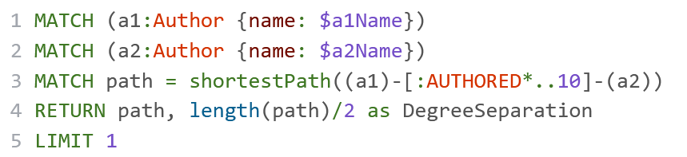
Graph DB Design
Shortest Collaboration Path
Domain-specific query: find the shortest way to reach an author using collaborations of another author
Graph-specific query: Find the shortest path between two Author nodes across AUTHORED edges, Paper and Author nodes
Notes:
Show the most important implemented ”graph-based” queries (suggestions and analytics) highlighting how the system benefits from the proposed DB design. Use Cypher Language

Slide 29
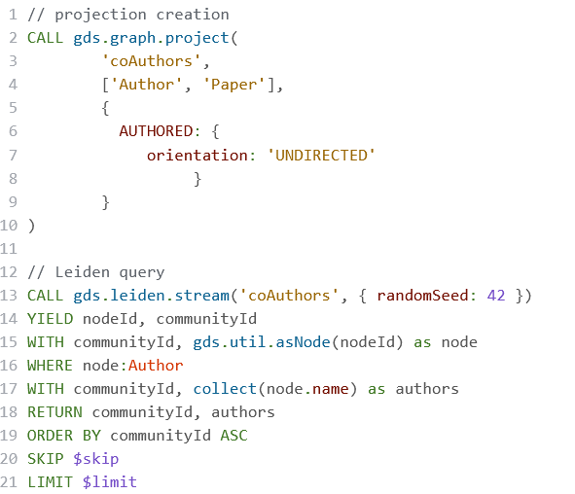
Graph DB Design
Hidden Leiden Communities
Domain-specific query: Discovers group of researchers that cooperate frequently and represent school of thought
Graph-specific query: Execute Leiden algorithm on co-Author subnetwork, in order to retrieve communities where authors are divided.
Notes:
Show the most important implemented ”graph-based” queries (suggestions and analytics) highlighting how the system benefits from the proposed DB design. Use Cypher Language

Slide 30
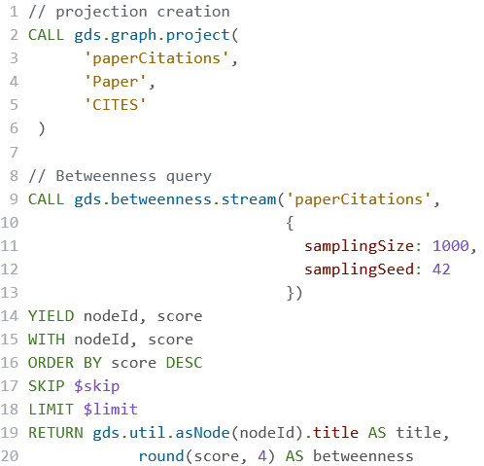
Graph DB Design
Betweenness of papers
Domain-specific query: Discover how much a paper is relevant in creating associations with other papers and authors
Graph-specific query: Estimate the betweenness centrality coefficient of paper nodes using paperCitations subnetwork, in order to identify most important Bridge paper nodes
Notes:
Show the most important implemented ”graph-based” queries (suggestions and analytics) highlighting how the system benefits from the proposed DB design. Use Cypher Language

Slide 31
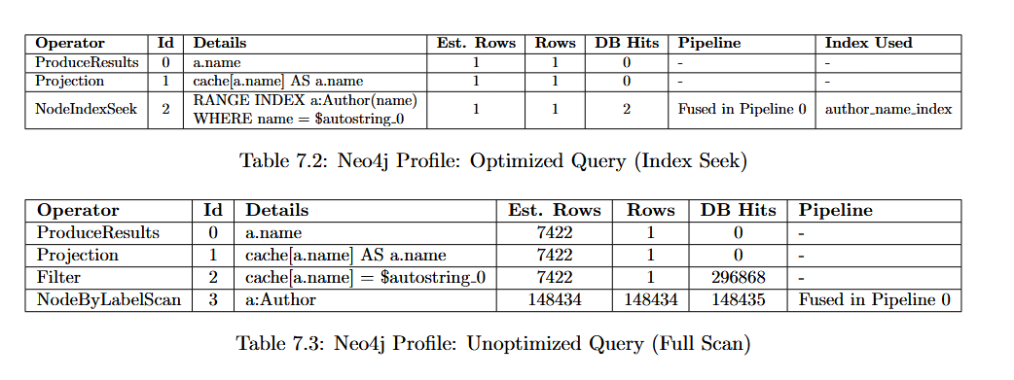
Neo4j Indexes
Operations’ performance is improved by using author_name_index, which will be used in queries that involves author node’s name field
Tests are done considering a query that involves all author nodes

Slide 32
Handling Intra-DB Consistency
Strategy: Synchronous Update with Defined Source of Truth
MongoDB
Neo4j
System of Record (Full Data)
System of Record (Full Data)
Primary Commit
On success
Graph Projection
System of Record (Full Data)
Topological Structure (Nodes/Edges)
The pattern: Synchronous Dual-Write. MongoDB acts as the Canonical Source
The Execution Flow:
  Write payload received.
  Data persisted to MongoDB.
  Data projected to Neo4j
  Transaction commits if both succeed.

Slide 33

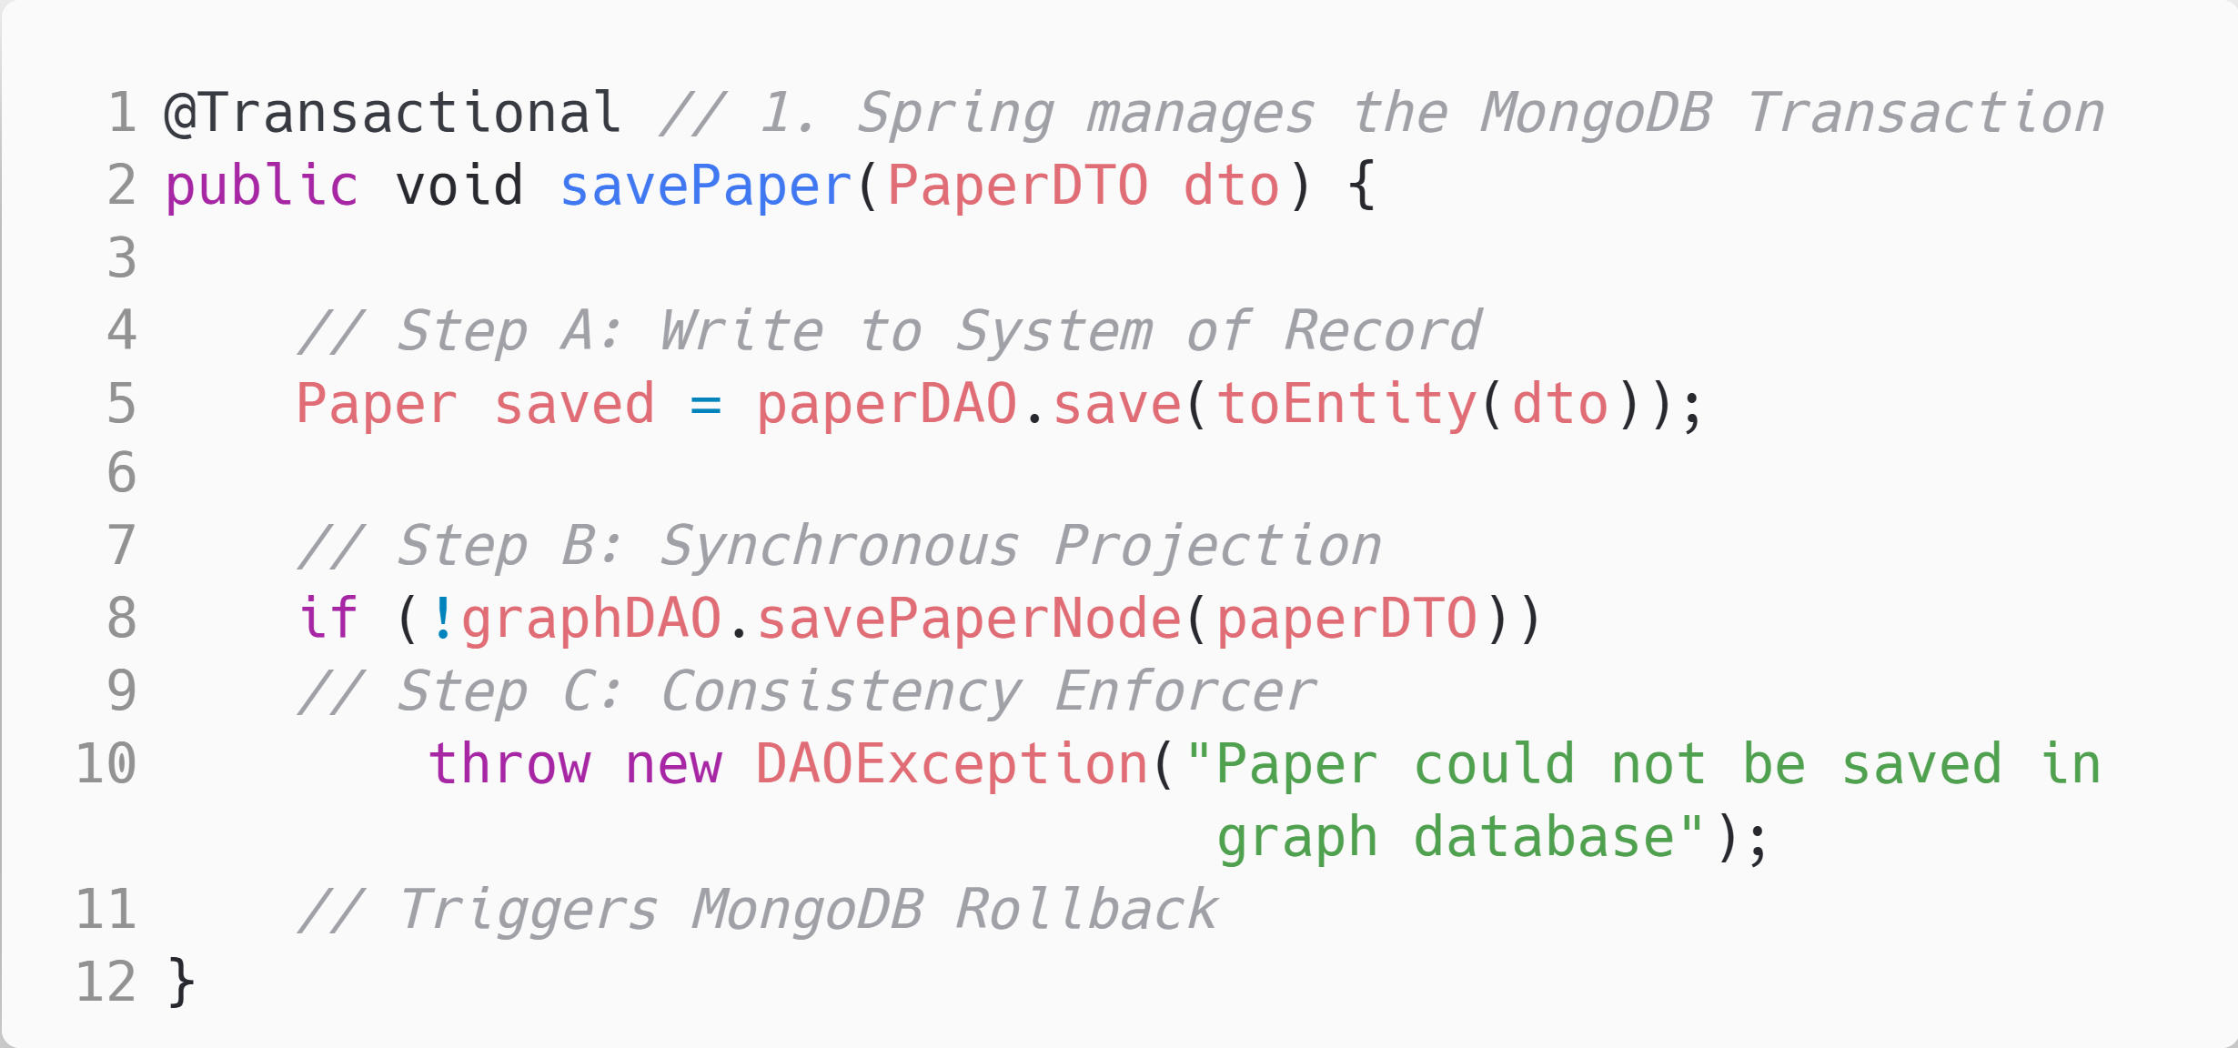
Implementation Details
Trigger:
Spring Transaction Manager.
Mechanism:
Exception Propagation.
Idempotency:
Neo4j uses MERGE to handle retries safely (preventing duplicate nodes).

Slide 34
Design Justification
Design Justification & Trade-offs
Strong Consistency (CP)
Trade-off: Write Latency
Rationale: A paper must not exist in the Document Store if it cannot be analyzed in the Graph
Cost: Synchronous dual-writes introduce network latency (MongoDB Write + Neo4j Write + Ack)
Outcome: Eliminates "phantom" data and ensures graph algorithms always run on the complete dataset.
Justification: The data velocity (DBLP/Semantic Scholar updates) is Batch/Low-Frequency.
Failure Mode: Fail-Safe Defaults
Behavior: If the Graph Database (Neo4j) is unreachable, the system rejects the write entirely.
Result: The system guarantees a clean state after recovery, requiring no manual reconciliation.

Slide 35





Testing and Validation
Testing Stack
Test Categories
JUnit 5
Testcontainers
Mockito
Unit Tests
Unit Tests
JaCoCo
Spotless
Continuous Integration (CI) Pipeline
1. Format Check
2. Build & Test
3. Static Analysis
Runs mvn spotless:check to ensure code style compliance.
Compiles the code and runs the full test suite (mvn clean verify).
Uploads coverage reports to Codecov and performs static analysis via Sonar-Cloud to detect bugs and code smells.

Slide 36
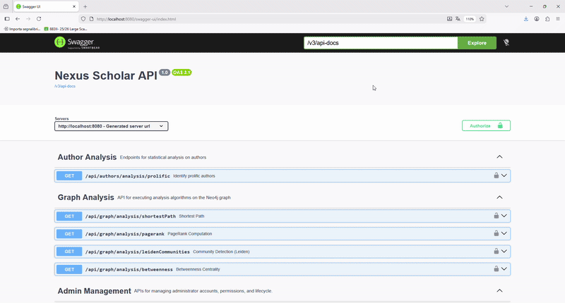
Swagger UI REST APIs documentation
Swagger doc url: http://10.1.1.80:8080/swagger-ui/index.html

Slide 37

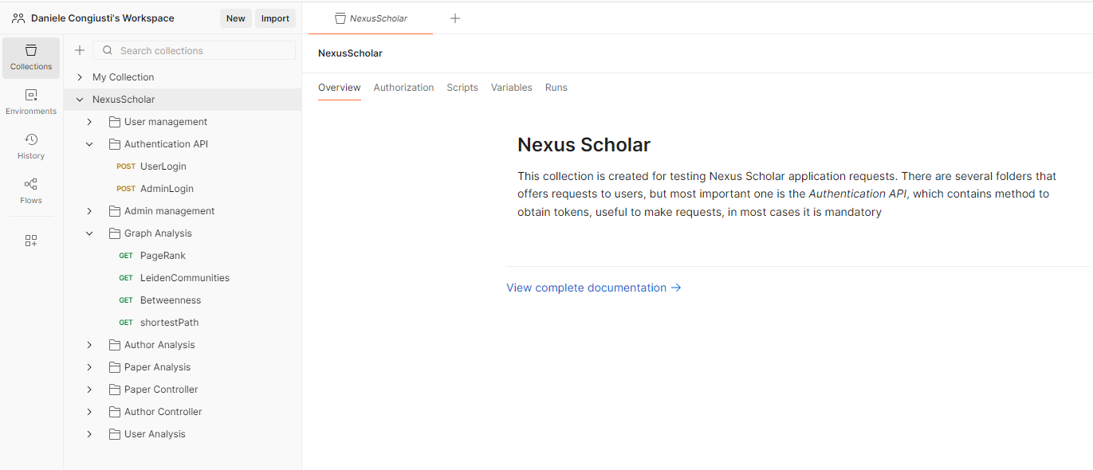
Live demo with Postman
Link postman collection

